Slide 1

R-Trees
Team Chronomancer
Daniel Woeste

Slide 2
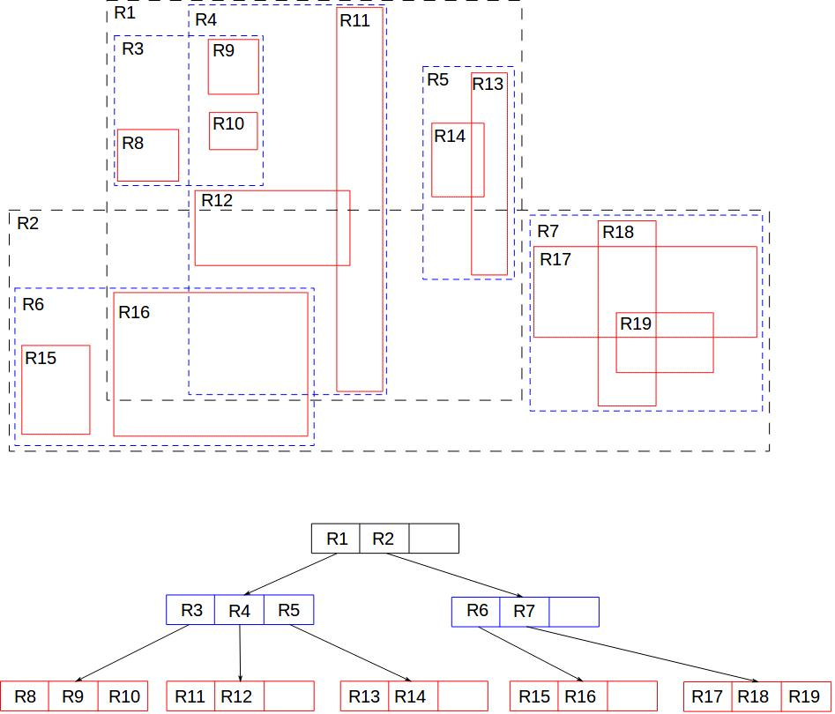
R-Trees
Tree like structure used to store and organize dimensional inforamtion.
Groups of points are organized using Minimum Bounding rectangles.
Each leaf is a single point or object.

Slide 3
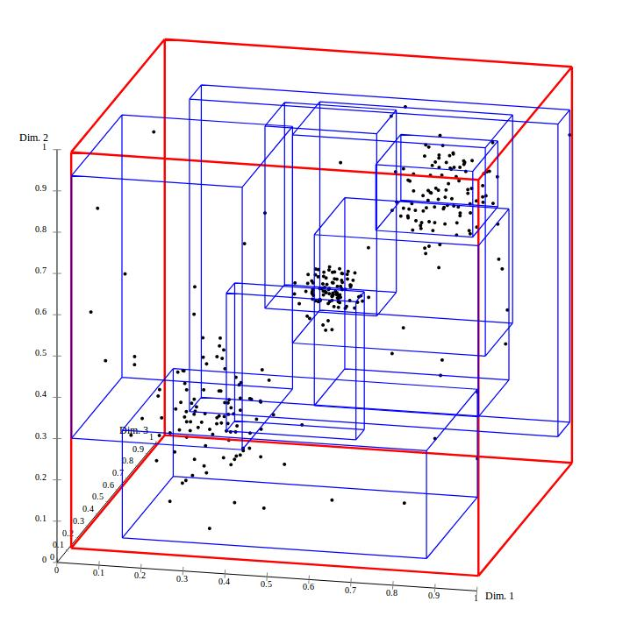
R-Trees in MariaDB
Data Type: GEOM
Spatial Indexes
Default storage engine does not support Spatial Indexes.
Used MyISAM
Geometry data includes Points, Lines, Polygons, etc.

Slide 4
Applications
GIS (Geographic Information Systems)
Google Maps: Sorting all restaurants in a city.
Originally developed for IC design
Used to determine if a space was taken
Object Recognition in vision systems.

Slide 5
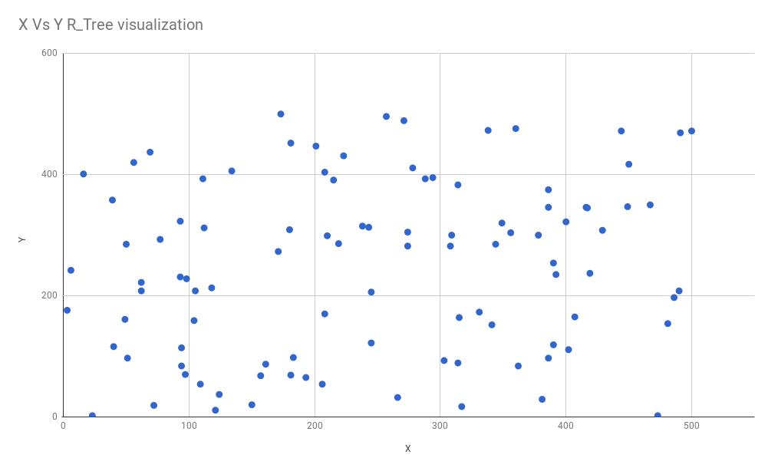
R-Tree Implementation - Data Set
100 randomly generated points in a 500 by 500 square.
Points because they are easier to visualize and work with

Slide 6
R-Tree Implementation
Creating Tables
CREATE TABLE R_Tree (TableName TEXT, ID INTEGER PRIMARY KEY NOT NULL AUTO_INCREMENT);
CREATE TABLE R_Tree_Node (NodeID INTEGER NOT NULL, g GEOMETRY NOT NULL, SPATIAL INDEX(g), CONSTRAINT `fk_R_Tree_ID` FOREIGN KEY (NodeID) REFERENCES R_Tree (ID) ON DELETE CASCADE ON UPDATE RESTRICT) ENGINE = MyISAM;

Slide 7
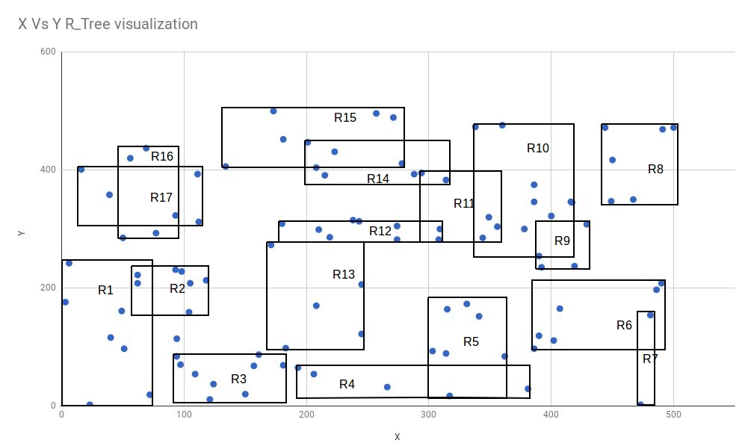
Adding data
Data Broken Down into the sub Boxes, Labeled R1-R17;
R1 in R_Tree matches to ID 1 in R_Tree Node.
Points added with
INSERT INTO R_Tree_Node (1, POINT(72,19);

Slide 8
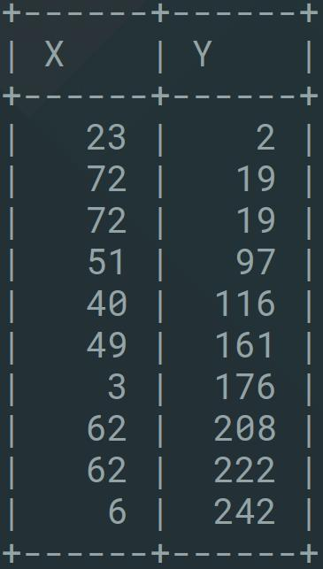
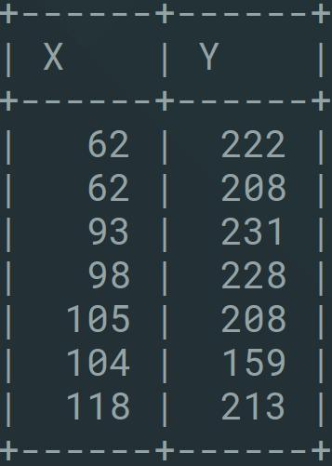
Multiple MBR can have the same data
R1 R2

Slide 9
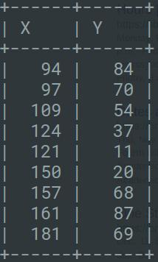
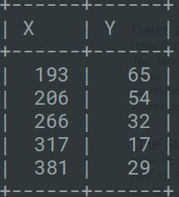
Final Structure
R0
R0
R1
R2
R3
R4

